Slide 1
A History of the Midwest Province of Brothers Congregation of Holy Cross (1956-2024)
Compiled by
Brothers George Klawitter, Philip Smith, Kenneth Haders,
James Spooner, Charles Smith, Robert Lavelle
and Dr. Mary Anne Beiting, Ed.D.

Slide 2
Brother Ephrem O’Dwyer, C.S.C. Provincial US Brothers Province 1946-1956
Reorganized formation for the brothers;
By 1956, doubled the number of brothers in final vows to more than 1,000;
On Nov. 1, 1956, US Province of Brothers becomes three groups: Midwest Province, Southwest Vice-Province and the Eastern Vice-Province.

Slide 3
Brother Donatus Schwartz, C.S.C. First Provincial Midwest Province 1956-1968
New ministries of province – Ghana and Liberia, West Africa;
Formation program initiated in Ghana;
Province sees Bengal missions as a priority relationship;
1964 – 399 finally professed brothers, 100 temporary professed and 49 novices.
1965: 10 high schools, 3 boys’ homes; one military academy.

Slide 4
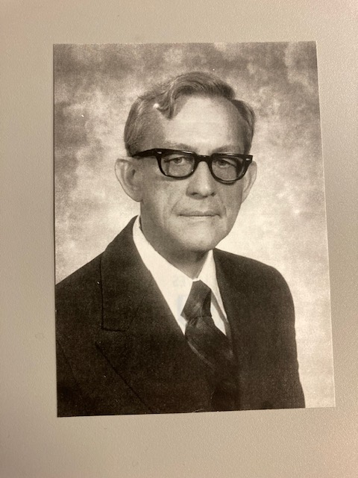
Brother Ernest Ryan, C. S. C. Founder of the Dujarié Press Brother Sigismund Danielski, C. S. C. Editor 1963-1968
Published over 350 books mostly about the lives of the saints and famous persons with an appeal to Catholic elementary students. Thousands of copies were printed and sold across the country. Today, one can purchase them on Amazon or eBay.

Slide 5
Brother Charles Krupp, C. S. C. Second Provincial 1969-1979
Biggest challenge was number of men choosing to leave the congregation.
His council mandated the creations of boards for all schools.
In 1972, formation moved from Rolling Prairie, IN to new houses in South Bend.

Slide 6
Brother Philip Armstrong, C. S. C. Third Provincial 1979-1985
Continued the establishment of boards in province schools.
Brothers were leaving education to work in other Church-related ministries.
A Hispanic outreach at Holy Trinity HS in Chicago, Il began because of the growing need for brothers to learn Spanish because of a desire to join ministries of the US Province in Chile and Peru.

Slide 7
Brother Thomas Moser, CSC Fourth Provincial 1985-1994
The number of brothers continued to decline with brothers ministering in only six high schools and one boys’ home.
Many brothers opt to begin second careers.
In 1988, the South-West Province published Vision and Governance the first attempt to put Moreau’s ideas from Christian Education as expectations for maintaining the Holy Cross traditions and values in our schools.
Midwest Province becomes intentional about who we are and to more fully include lay colleagues in all aspects of a mission.

Slide 8
Brother Carl Sternberg, CSC Founder and Director Associates of Holy Cross
Begun in 1994 in Palm Desert, CA, the Associates was a group lay persons who wanted a close connection with the brothers, to share in their spirituality and prayer life.
In 2012, Holy Cross Associates became a separate nonprofit organization under the title Midwest Holy Cross Associates.

Slide 9
Brother John Driscoll, CSC First President of Holy Cross College
In 1966, Br. John Driscoll, the first president, established the school as a two-year junior college, primarily to educate Holy Cross Brothers.
In 1967, lay male students from the surrounding area started enrolling; the college became coeducational in the fall of 1968.
In the 1990s, President Brother Richard Gilman, increased its enrollment and academic offerings, and started to offer four-year bachelor degrees.
In 2017, Rev. David Tyson, CSC became president and due to a land sale to the University of Notre Dame and a reorganization of the curriculum, the College saw its financial situation improve and its enrollment increase.
In 2023, Dr. Marco Clark was appointed the College’s first lay president.

Slide 10
Brother William Geenen, CSC Fifth Provincial 1994-2000
While in Sarasota, FL, founded the Senior Friendship Centers.
As provincial, he began the development of new housing and services for senior citizens. Today, Holy Cross Village has a mission statement to build the best senior care community that is energized by Holy Cross spirituality and hospitality centered on a commitment to serve others as a ministry of the Brothers of Holy Cross.
In 1997, Holy Cross Educational Ministries was established as a “sponsorship office” to focus on developing resources and programs for mission effectiveness among all members of school communities.

Slide 11
Brother Donald Gibbs, CSC Sixth Provincial 2000-2002
Term contentious
Resigned October 25, 2002

Slide 12
Brother Robert Fillmore, CSC Seventh Provincial 2002-2009
Holy Cross College becomes a four-year school.
In 2004 the Holy Cross Institute at St. Edward’s University was established.
As the number of brothers in the US continued to greatly diminish, the South-West and Eastern provinces of brothers announced their decision to merge into the Moreau Province. The Midwest Province chose not to be part of the merger.

Slide 13
Brother Chester Freel, CSC Eighth Provincial 2009-2018
In 2009, Cathedral High School in Indianapolis asked to be sponsored by the Midwest Province.
In 2010, Columba Hall renovation completed.
In 2013, Notre Dame Prep for Boys in Niles, Illinois joined the sponsored network of schools.
Today, there are six sponsored schools and one college in the Midwest Province.
The 2015 Chapter formally endorsed collaborative programs developed with the Moreau Province: one vocation director, a defined program for discernment, and an initial pre-novitiate formation at Holy Cross College.

Slide 14
Brother Kenneth Haders, CSC Ninth Provincial 2018-2024 +
Continues to oversee and support all province ministries.
Works diligently along with others to assist the District of Ghana to become the Province of West Africa.
Working to provide the due diligence for the unification of the three provinces in North America. By 2028.
As of this date there are 55 members of the province with only seven under the age of 75.

